Slide 1
WWW.MENTORNESS.COM
MENTORNESS
Hotel Reservation Analysis with SQL Project
Mohd Danish

Slide 2
Introduction
Hotel Reservation System is online software that allows guests to schedules the dates and length of the stay, select room types and make payments in one place.

Slide 3
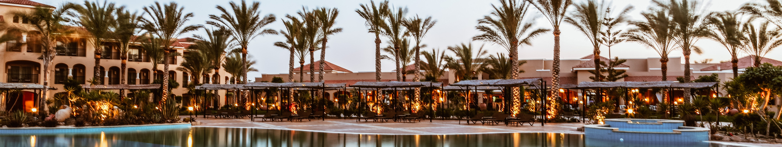
Table
of Content
01.
Import Data Set
05.
SQL Query
02.
Transform Data
03.
Data Set Details
04.
Tasks

Slide 4
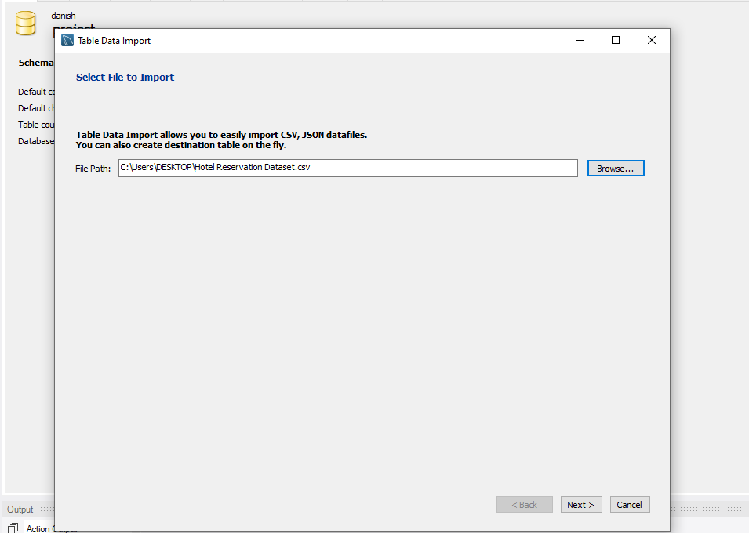
Import DataSet

Slide 5
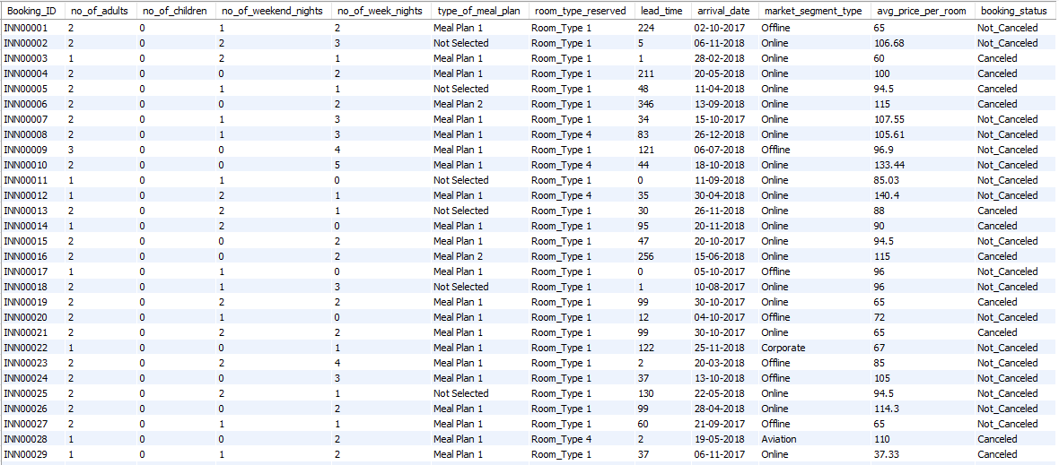
DataSet
Rows: 700
Column: 12

Slide 6
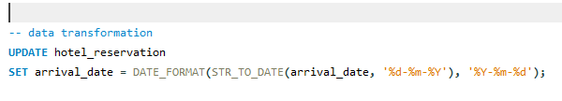


Transform DataSet
We need to convet date formate of Data.
(dd-mm-yyyy)
(yyy-mm-dd)

Slide 7

DataSet Details
Booking_ID: A unique identifier for each hotel reservation. no_of_adults: The number of adults in the reservation.
no_of_children: The number of children in the reservation. no_of_week_nights: The number of nights in the reservation that fall on
weekdays.
no_of_weekend_nights: The number of nights in the reservation that fall
on weekends. type_of_meal_plan: The meal plan chosen by the guests.
room_type_reserved: The type of room reserved by the guests.
lead_time: The number of days between booking and arrival.

Slide 8
arrival_date: The date of arrival.
market_segment_type: The market segment to which the reservation belongs.
avg_price_per_room: The average price per room in the reservation.
booking_status: The status of the booking.

Slide 9
Tasks
What is the total number of reservations in the dataset? Which meal plan is the most popular among guests?
What is the average price per room for reservations involving children?
How many reservations were made for the year 20XX (replace XX with the desired year)?
What is the most commonly booked room type?
How many reservations fall on a weekend (no_of_weekend_nights > 0)?
What is the highest and lowest lead time for reservations?
What is the most common market segment type for reservations?

Slide 10
How many reservations have a booking status of "Confirmed"?
What is the total number of adults and children across all reservations?
What is the average number of weekend nights for reservations involving children?
How many reservations were made in each month of the year?
What is the average number of nights (both weekend and weekday) spent by guests for each room type?
For reservations involving children, what is the most common room type, and what is the average price for that room type?
Find the market segment type that generates the highest average price per room.

Slide 11




SQL Query

Slide 12

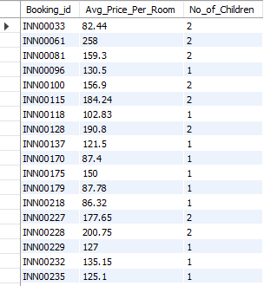



Slide 13





Slide 14




Slide 15





Slide 16
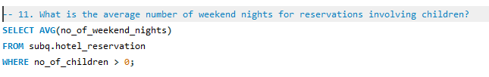

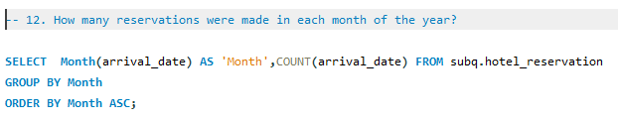
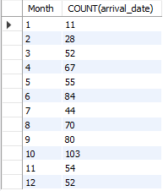

Slide 17
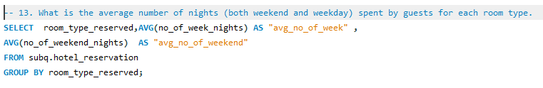
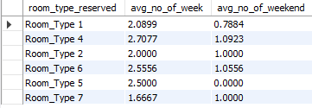
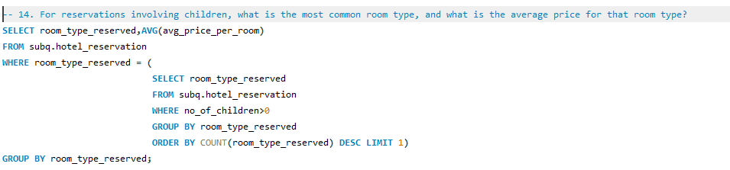


Slide 18
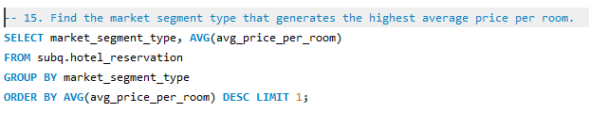


Slide 19

Mohd Danish

